Slide 1
Bike sale data analysis
Ruth Wetters

Slide 2
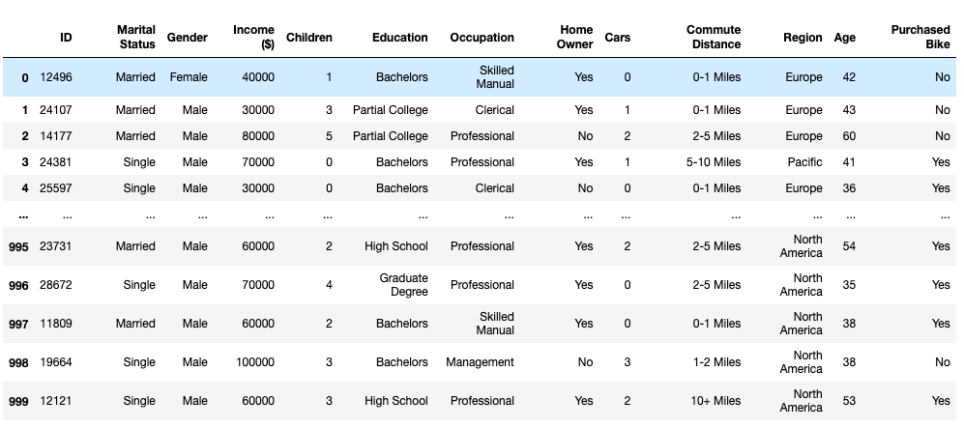
Dataset summary
1000 rows, 13 columns
No missing values
Balanced dataset

Slide 3
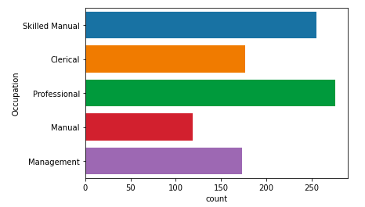
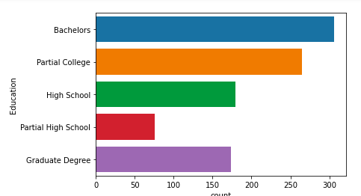
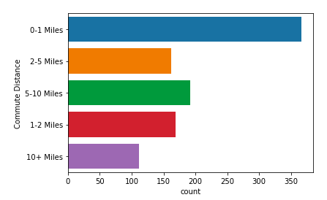
Breakdown
Average respondent is 44 years old with 2 children and 1.5 cars
Average respondent income is $56140
Half of respondents are from North America (508/1000)
⅔ of respondents are homeowners (685/1000)

Slide 4
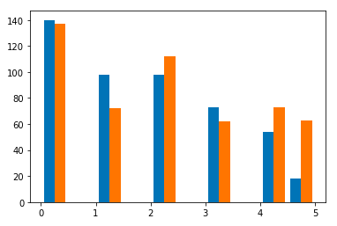
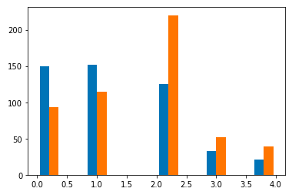
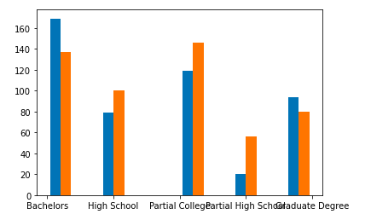
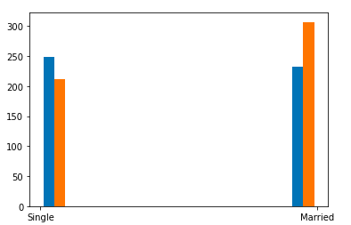
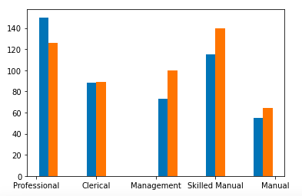
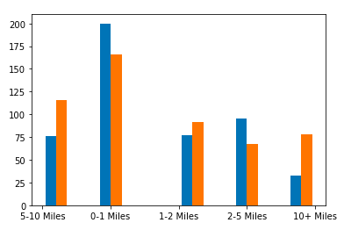
Pairwise comparison (blue = purchased bike)
Children
Cars
Education level
Marital Status
Occupation
Commute Distance

Slide 5
Regional breakdown of factors predicting bike sale
Pacific:
Aged 20-30
Manual workers
Childless
No car
Note: Pacific respondents are the most likely to purchase a bike
Europe:
Aged 30-40
Graduate degree holders
No car
North America:
Aged 30-40
Professional
Single
Commuting 2-5 miles

Slide 6
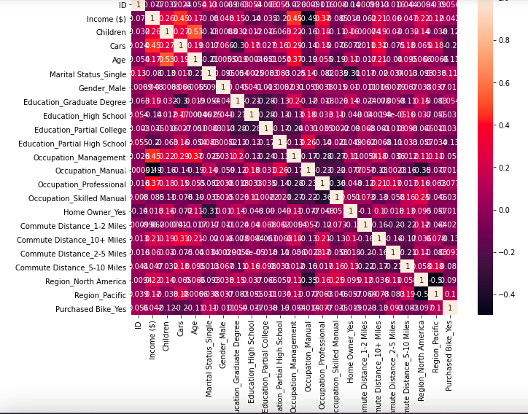
Correlation matrix

